Slide 1
Aim:
- To bring training to the council level
How:
- Utilize training teams throughout the state
- Use Supreme’s vast training materials

Slide 2
Major Conference Coordinators
Their task is to oversee the training of the minor conferences under their area
Downstate Coordinator is Chales Nesto
Long Island Coordinator is John Arcate
Upstate Coordinators are
Jack McArdle for Northern and Central
Kevin Fitzpatrick for Finger Lakes and Western
Note: Due to the large area of Upstate splitting up the minor conference was appropriate
Under each Major Coordinators are:
Minor Conference Coordinators with the task of overseeing the training in their area and to assist as needed
Also, in each conference a FS trainer will be available for any questions or help

Slide 3
Key guides to successful council Development
Protocol, Meetings, and Ceremonials
#11620
- Protocol
Protocol
Correspondence
Speakers and Speeches
Head Table
Protocol for head table seating
Procession
- Council Meetings
Elements of a successful meeting
Parliamentary procedure
- Ceremonials
FraternalExcellence Guide
#11619
- Council Leadership
Membership Director Section
Grand Knight Section
Financial Secretary Section
District Deputy Section
- Council Recovery Program
- General Section
Evangelization & Faith Formation
Protocol
Patriotic Degree
Insurance Matters
Safe Environment Program-

Slide 4
Type on address line: KOFC.ORG the top part of next screen is below
Click on

Slide 5
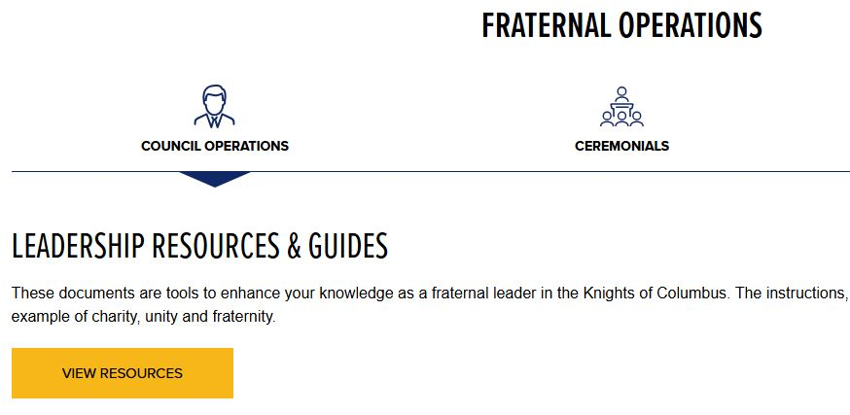
Click on

Slide 6
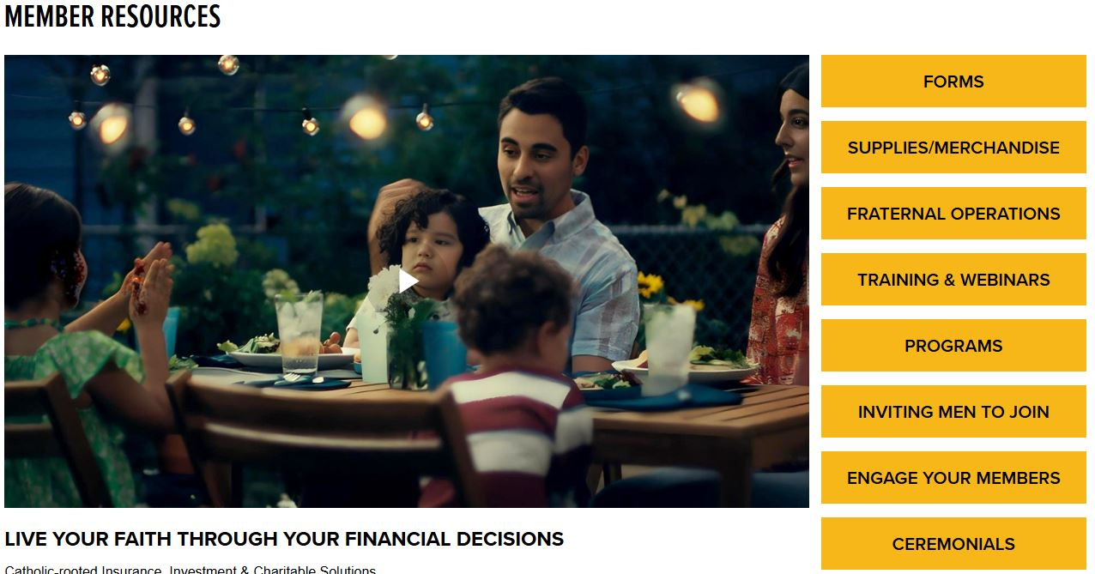
Click on

Slide 7
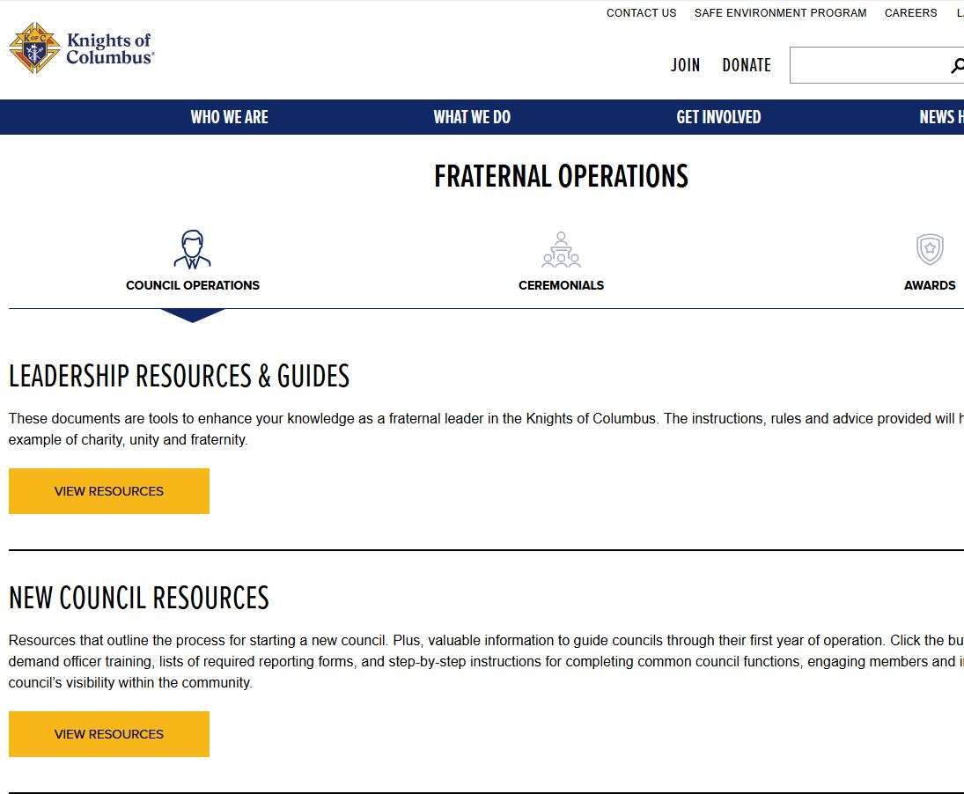
Click on

Slide 8
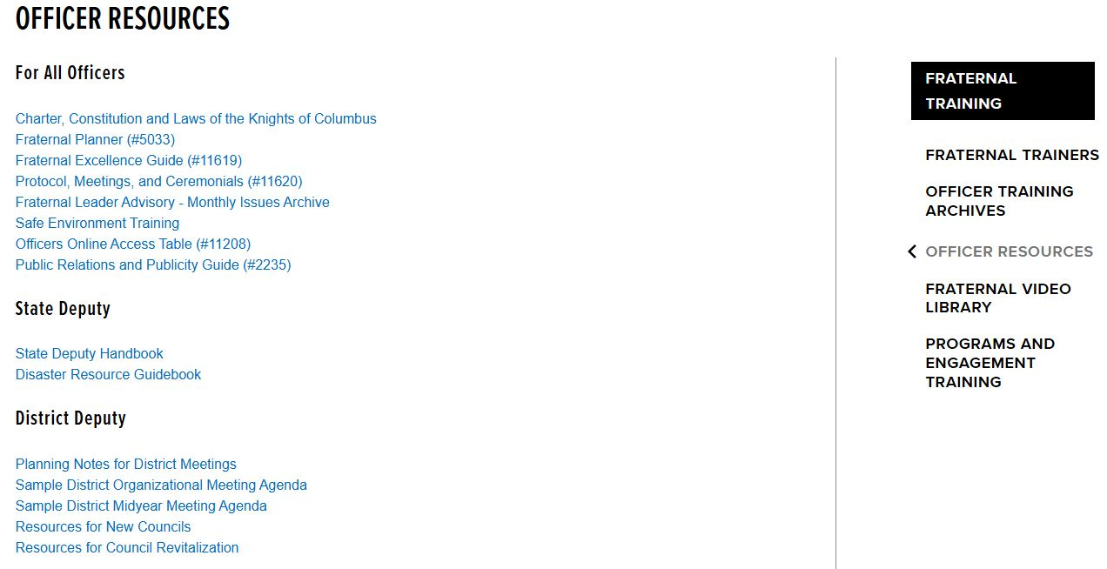

Slide 9
Training Director
Daniel T. Keenan
Email: dkeenankofc@gmail.com
Phone: 845-401-6304

