Slide 1

State Org Meeting 2025: Cor
Notes:
WELCOME AND Intro – START WITH A PRAYER
HERE IS WHY WE ARE DOING THIS

Slide 2
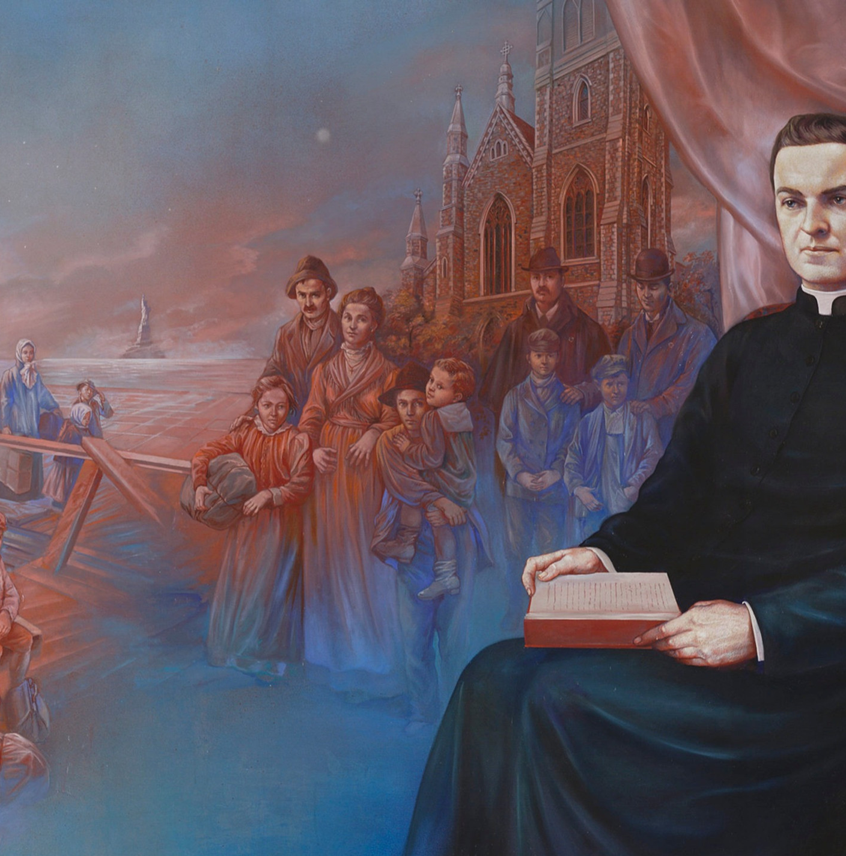
Cor Connection – Mission Narrative
Father McGivney had a clear mission:
    Form men in their faith
    Protect the family
  Is this mission relevant today?
Notes:
This mission is not only relevant, but extremely important and needed

Slide 3
Cor Video - https://www.youtube.com/watch?v=gaVD4oqvnSs
Be sure to download this video prior to showing at meeting. Do not rely on the internet for your presentation!
Notes:
https://www.youtube.com/watch?v=gaVD4oqvnSs

Slide 4
Mission and Vision of Cor
Mission: To help focus Catholic men on Jesus by building Christ-centered brotherhood through a flexible framework of prayer, formation and fraternity.
Vision: To aid in transforming the hearts of men through Christ-centered brotherhood. Rooted in prayer, formation and fraternity, men will be sharpened in faith and virtue as they cultivate authentic friendships with Christ and each other.
Notes:
We envision a future where Cor continuously helps sustain these men to lead their families, strengthen their parish communities and courageously evangelize the world as missionary disciples of Jesus Christ.

Slide 5
Cor Overview
Flexible structure of prayer, formation and fraternity
GK appointed Evangelization and Faith Formation Director (EFF) runs Cor
Pastoral approval – collaborate alongside other ministries
Weekly, Bi-Weekly, or Monthly
60-90 minutes
Supplemented prayer and formation content from KofC and FORMED
Notes:
For those of you who may be seeing this for the first time; it will be good to explain the basic framework of prayer, formation and fraternity.
HOW DO YOU DO THIS IN YOUR COUNCIL?

Slide 6
Cor Success
Long Term :
    Cor in every parish – prayer, formation, and fraternity for every man
Short Term:
    Continue the culture shift through awareness – share the mission
    Appoint good leaders – Evangelization and Faith Formation (EFF) Directors and team
      www.kofc.org/forms - Council EFF Dir. Submission Form
Notes:
A great video to hear how Cor is making a difference…As Sean said, my name is …One of the blessings…work directly with the State EFF Directors.
We are here to help you succeed….HOW? See Success Guides…every man should have the opportunity
Cultural shift? Is there a reason so many men’s ministries are growing?
Good leaders…tangible ways to measure/gauge success – knowing who is leading Cor
Cor is simple; providing the space for Christ-centered brotherhood. How can you provide that without a leader?
Any smart leader will also have a support team…

Slide 7
Cor Success in our State
As of 30 June – 55 Councils running Cor across the state:
    Upstate - 11
    Downstate - 23
    Long Island - 21
Most groups are meeting monthly
Several Councils in final preparation stages to start
Our goal for this Columbian Year - 100 + Councils

Slide 8
State and Local EFF Structure
State EFF Director - Jim Corrigan
    Upstate EFF Coordinator – Mike Langlois
    Downstate EFF Coordinator – Dan Clifford
    Long Island EFF Coordinator – Hector DeMarchina
Clergy Support
    State Chaplain – Fr Brian McWeeney
    Pastors and Council Chaplains – Their endorsement is key
Council EFF Director (GK appointed)
    www.kofc.org/forms - Council EFF Dir. Submission Form
Notes:
Structure = Success
Pastors approval is necessary, but w

Slide 9
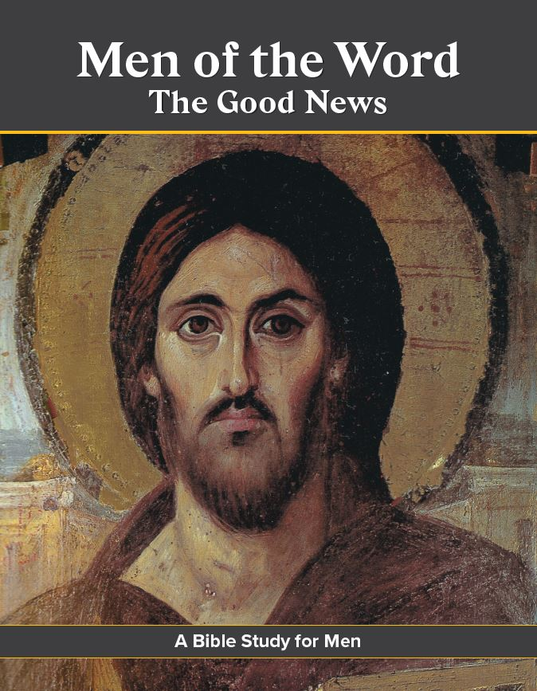
Faith Formation and Prayer Content
Everything available on Supplies Online and CIS:
    How to pray the Rosary
    Men of the Word
    Patris Corde
    Into the Breach
    Holy Hour
    Supreme Chaplain's Monthly Challenge
    Booklet and Devotionals
    And much more!
Notes:
All of these resources can be ordered through Supplies Online in Officers Online or at shopcatholicinfo.com
Also, you can find these resources at www.kofc.org/cor

Slide 10
Knights and FORMED
    All State Deputies, State Chaplains, State EFF Directors, and Council EFF Directors will have free access to FORMED
    Supreme will provide login directions for Council EFF Directors once appointed and submitted via the submission form.
    FORMED’s award-winning content will now be available to support formation in Cor
    A new KofC Content Page on FORMED features recommended premium content
Notes:
WE CAN ONLY GIVE ACCESS TO LEADERS THAT WE KNOW EXIST! Please submit the EFF Director Form so we know who you are and can grant you access.

Slide 11
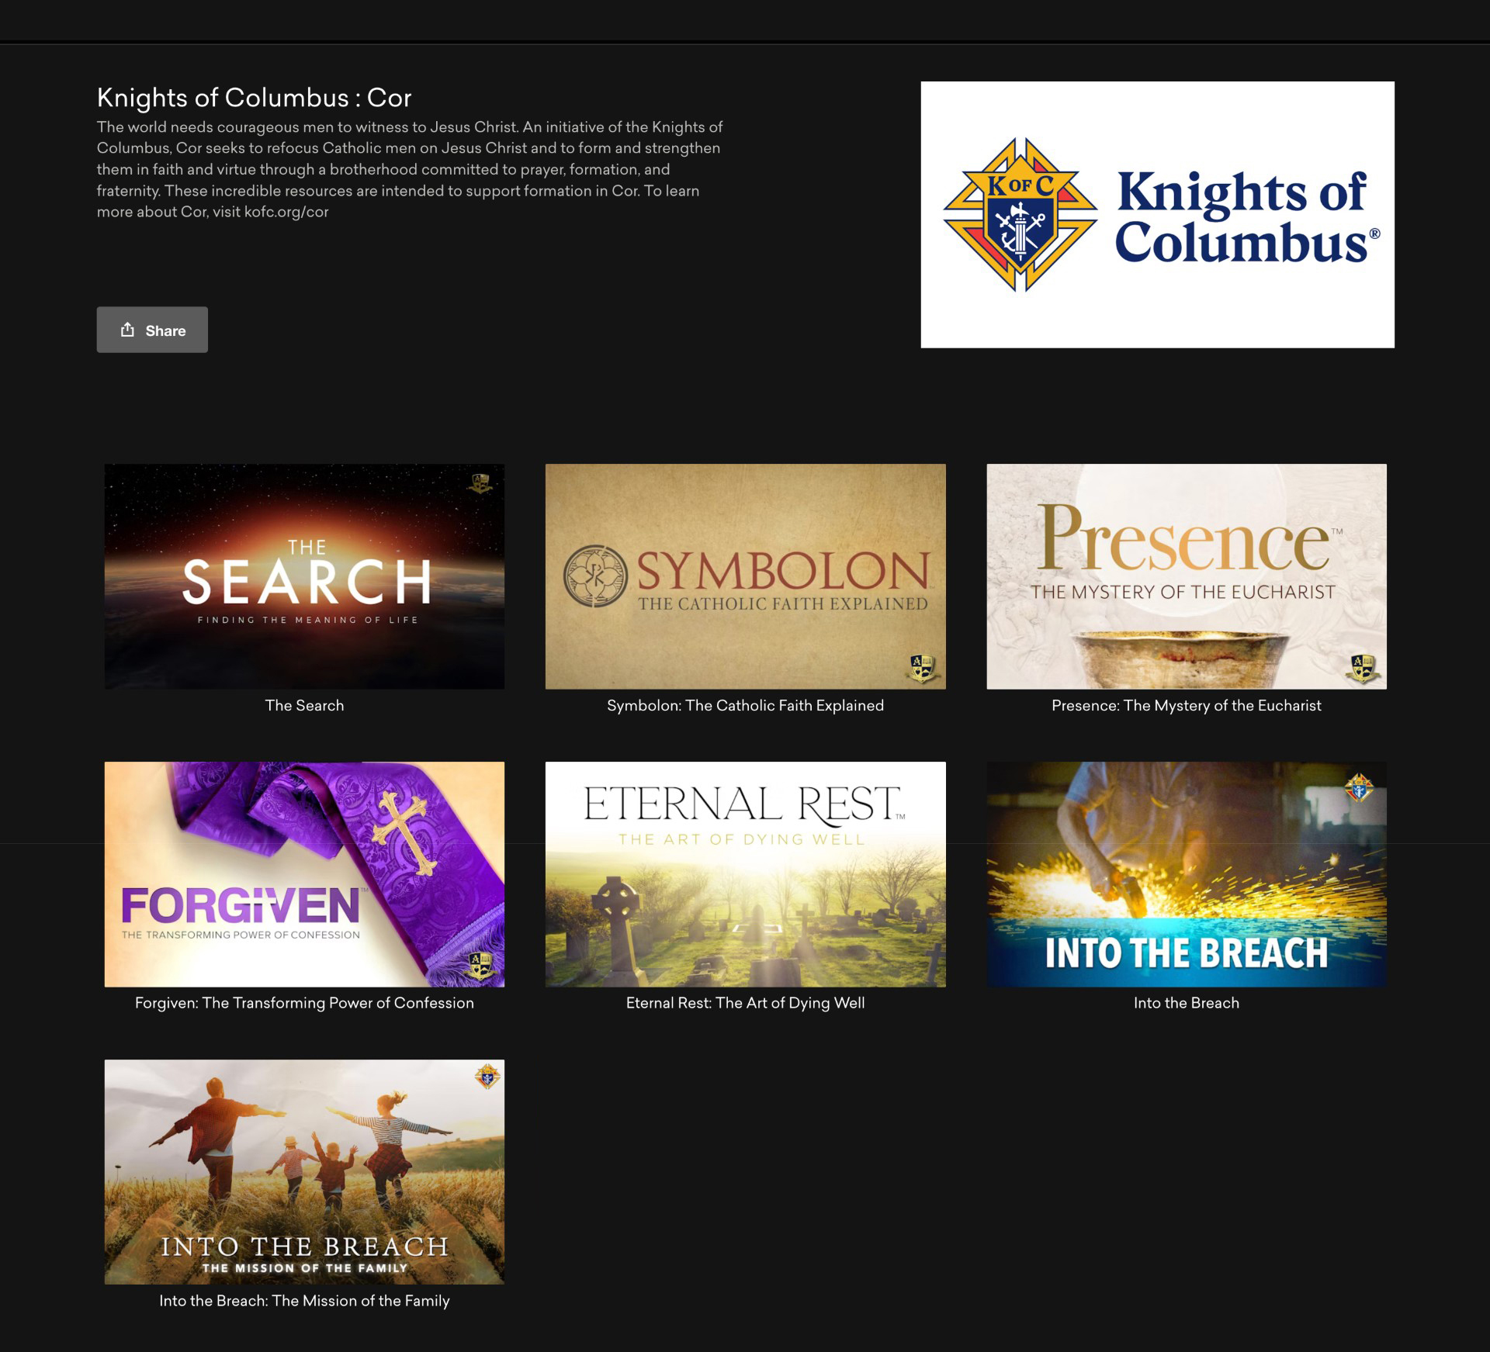
Notes:
This is the KofC Cor page in FORMED

Slide 12
Supreme Support
Ongoing Training and Formation for leaders.
    New Cor Startup Training Videos
    New onboarding emails for Council EFF Directors (when submitted on Council EFF Dir. Form)
Communication:
    Cor Quarterly Newsletter
    Fraternal Leader Advisory email
  www.kofc.org/cor

Slide 13
Action Items:
District Deputies
    Accurate reporting of Cor activity in #944 Form
Grand Knights
    Identify or reappoint your Council EFF Director and submit the Council EFF Director Form – www.kofc.org/forms
      Please submit EVEN IF A REAPPOINTMENT
    Please share my email – KofCJim.cor@gmail.com
Attend Cor and share your personal testimony!
    Most compelling story

